Slide 1
DATA WRANGLING L6
Christina Simbenga

Slide 2

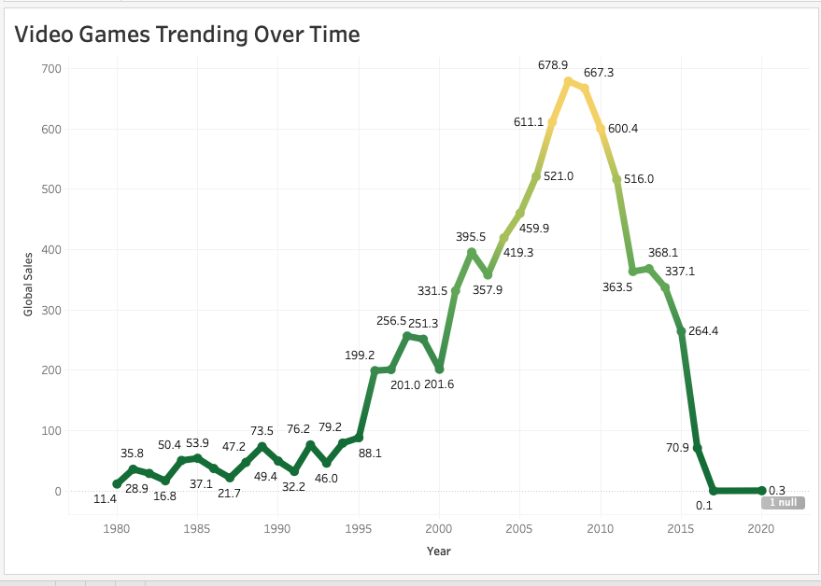
How video game sales have been trending over time
No interest in late 1980s but an increase occurred between 2005 to 2010 when video Games were being purchased a lot more

Slide 3
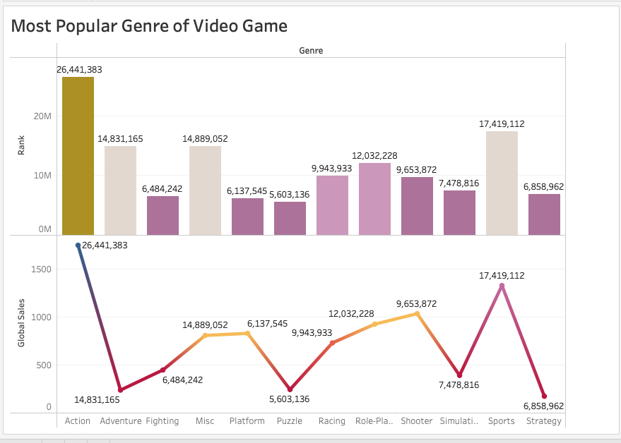
The most popular genre of video game
The most popular video game genre was action that also had 26,441,383 in global sales

Slide 4
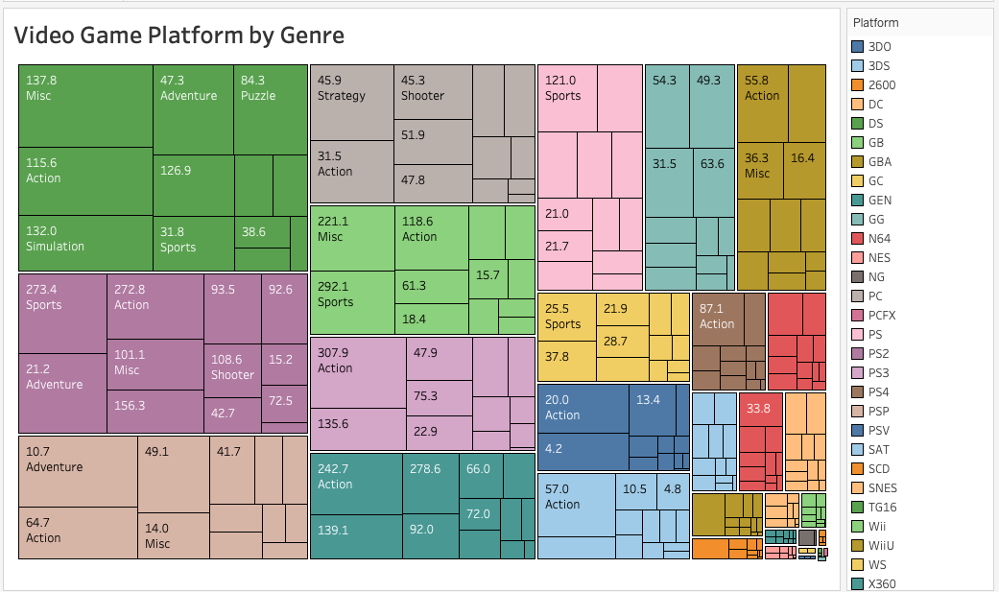
A comparison of video game platforms by genre
When comparing video game platform to genre we see that DS is the most used platform and mostly used for misc games.
PS2 is mostly used for sports
PSP for adventure and PC for strategy games
This helps us to recognize that certain platforms are best for certain genres of games

Slide 5
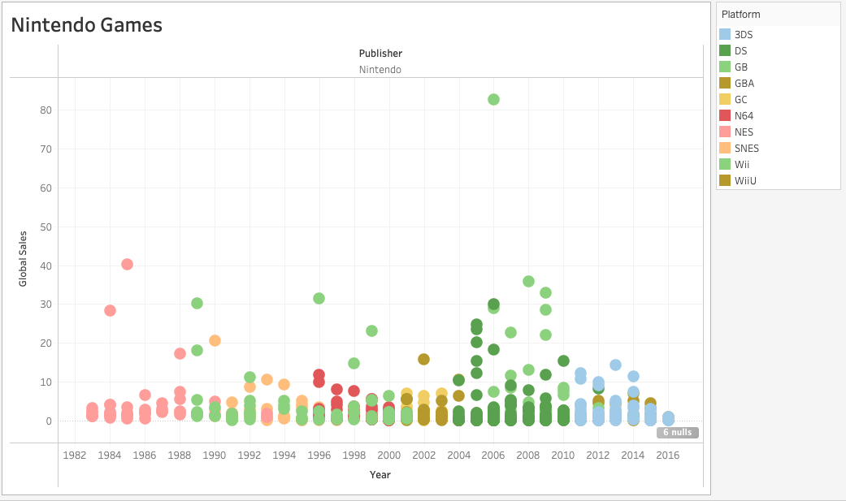
A visual looking at only games by Nintendo
Looking at only the publisher Nintendo…
We see the most popular platform being Wii where sales are high for the wii sport games
GBA being the least used platform with low ranking on 0.03 on the game Calico bit

